Slide 1
Phylogenetic Analysis and Reconstruction of the Panthera Lineage
Alexandra Gonzalez
April 2020

Slide 2

Intro: Article Reference
Supermatrix and species tree methods resolve phylygenetic relationships within the big cats, Panthera (Carnivora: Felidae)
Davis, Brian W., et al. “Supermatrix and Species Tree Methods Resolve Phylogenetic Relationships within the Big Cats, Panthera (Carnivora: Felidae).” Molecular Phylogenetics and Evolution, vol. 56, no. 1, 2010, pp. 64–76., doi:10.1016/j.ympev.2010.01.036.

Slide 3
Intro: Article overview
Problem- The evolutionary history of the five big cats- the lion, tiger, leopard, snow leopard, and jaguar-, along with their closely related clouded leopard, has been concealed because there is very little information provided in the fossil record, as well as rapid radiation that took place during the Pliocene era (~5.3-2.6mya), speciation between the genus Panthera less than 1mya, and possible hybridization between these lineages after their separation as individual species.

Slide 4
Intro: Overview Cont.
Purpose for this study- This lineage contain vulnerable and endangered species like the tiger and jaguar due to human influence in the ecosystem.
Conservationists want to use genetic data to make an action plan that could help prevent these numbers going down even more and create a balance in the ecosystem.

Slide 5
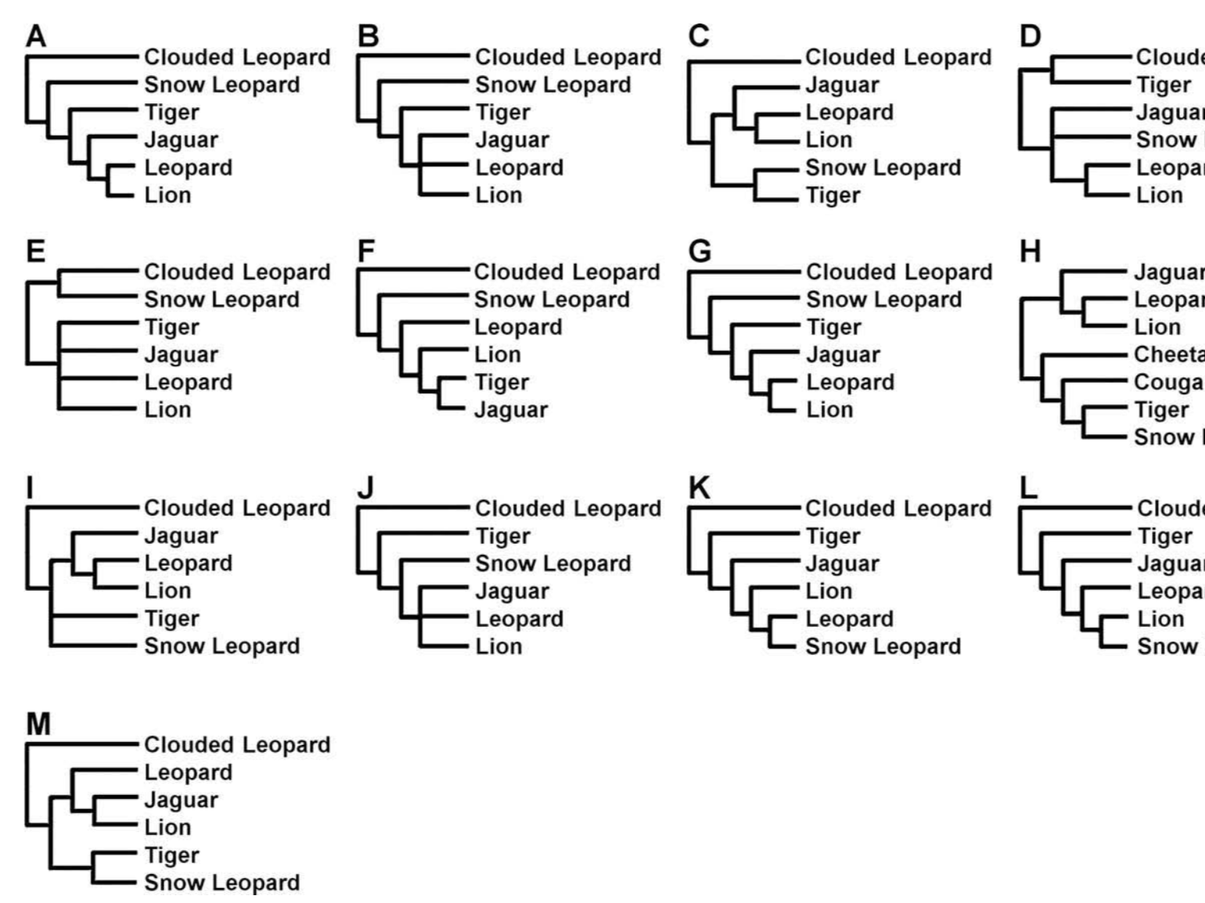
Article Discussion: Figure 1
Trees A and B are based on morphological characters; C-M are based on either biochemical or molecular studies. The problem in determining which tree is the “right” tree lies here.

Slide 6
Methods and Data Used
To obtain gene sequences and mtDNA sequences, researchers used GenBank and BLAST
Some sequences and accession numbers were taken from other studies such as Johnson’s W.E. articles
Sequence alignment0– ClustalX 2.0.3
Maximum Likelihood Analysis- PAUP 4.0b10
Bootstrapping done with 1000 iterations with TBR branch-swapping
Bayesian Interference- MrBayes 3.0.4
Bayesian estimation of species tree (BEST)- modified MrBayes package
Notes:
Sequence Alignement:
(1) Y chromosome
(2) autosomae
(3) X chromosome
(4) mitochondrial
Combinations of partitions were also defined as (5) nuclear (Y chromosome, X chromosome, and autosomes)
(6) uniparental (Y chromosome and mitochondria).
Bayesian Interference:
For individual gene segments, it ran 1.5 mil generations and saved every 100th tree; discarded the first 250000 as burn-in.
For the 6 matrices, the MCMC algorithm ran for 3.o mil gen., with every 100th tree saved and first 750000 discarded
Treespace was use
BEST
Used to construct a species tree from individual Bayesian genes
MCMC algorithm ran for 10 mil gen., saving every 1000th gene tree and discarding the first 1mil as burn-in
Results: Final species topology with support values listed as posterior probabilities

Slide 7

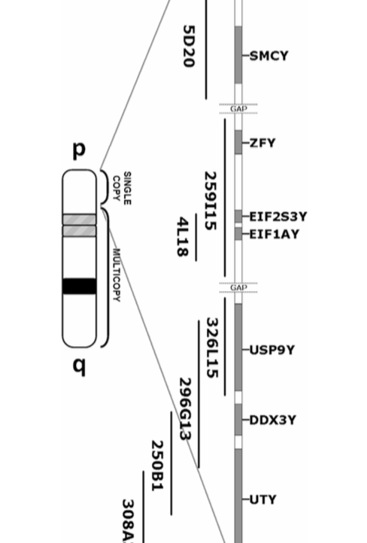
Figure 2:
Single-copy X-degenerate region of the domestic cat Y chromosome, and selected RPCI-86 BAC library clones
Notes:
Physical amp of the domestic cat single-copy Y-linked gene region and the corresponding BAC (bacterial artificial chromosome) clones DNAs used for PCR amplification. This domestic cat gene was used in the study to build the Supermatrix.
The complete domestic cat cDNA sequence for each Y-linked. X-degenerate, single-cope gene was obtained from GNBank
Matrix analysis results: The final supermatrix consisted of 47,628 nucleotides (974 sites excluded as either gaps or ambiguous) partitioned as follows:
MSY (19,140 bp), autosomes (19,124 bp), X chromosome (3223 bp) and mitochondria (6141 bp). The MSY partition was significantly less homoplastic than all other regions of the genome .

Slide 8
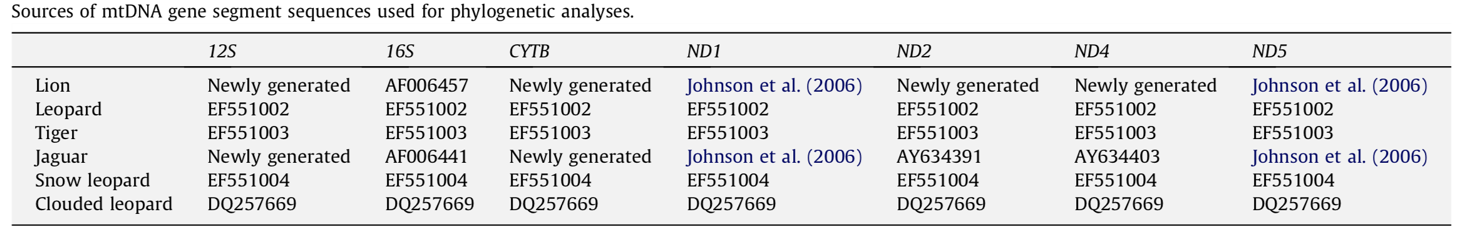
Accession Numbers used for Sequence data of each species

Slide 9
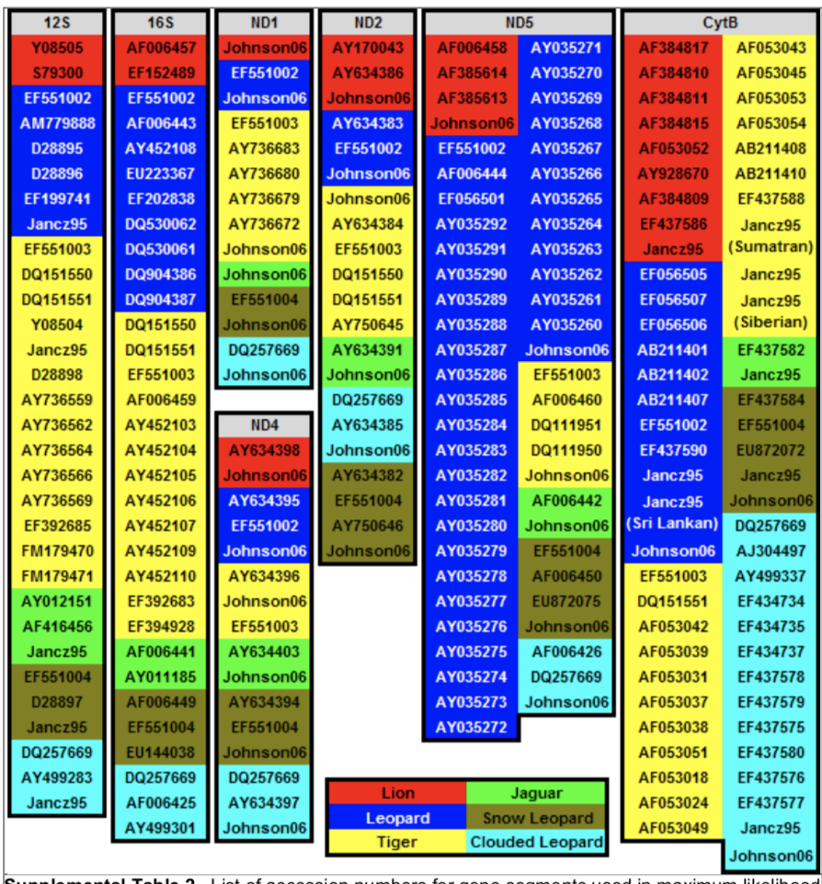
Notes:
Supplemental Table 2

Slide 10
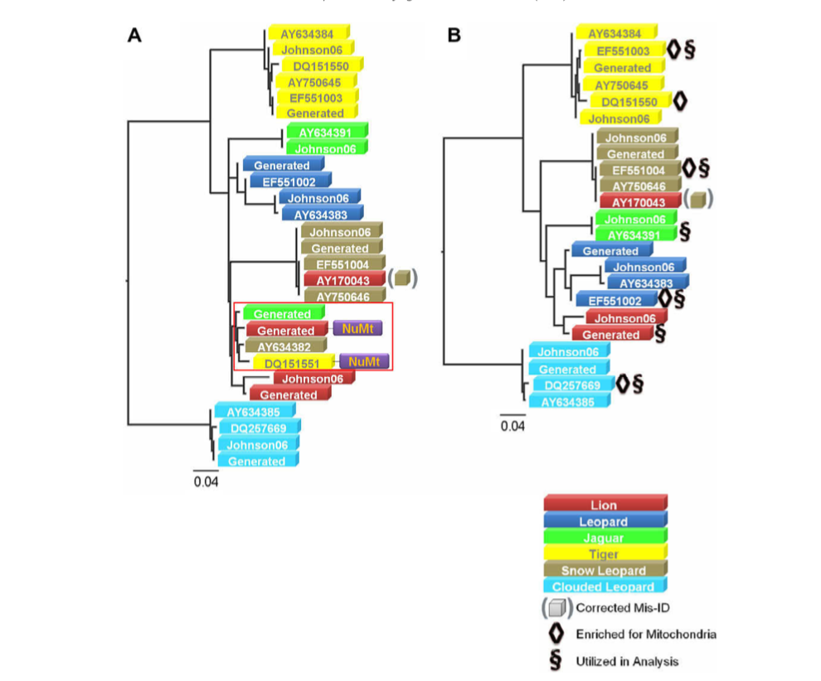
Figure 3
Maximum likelihood tree (GTR + C) of all published and new ND2 mtDNA gene segments
Notes:
Clear evidence of a mitochondrial to nuclear translocation event (numt) amplification withing the red box
ML tree with numts removed
Misidentification is shown with the lion sequence that groups in with the snow leopard
Reason for taking away the numts:
Because the majority of all previous phylogenetic studies of Panthera relied at least partially on mitochondrial data, the pub- lished existence of Panthera numts raised the possibility of numt amplification for these sequences
By including all published and novel (i.e. those identified in this study) numts, as well as the complete mtDNA genome sequences that are putatively cyto- plasmic in origin, we readily identified and removed numts from the dataset

Slide 11
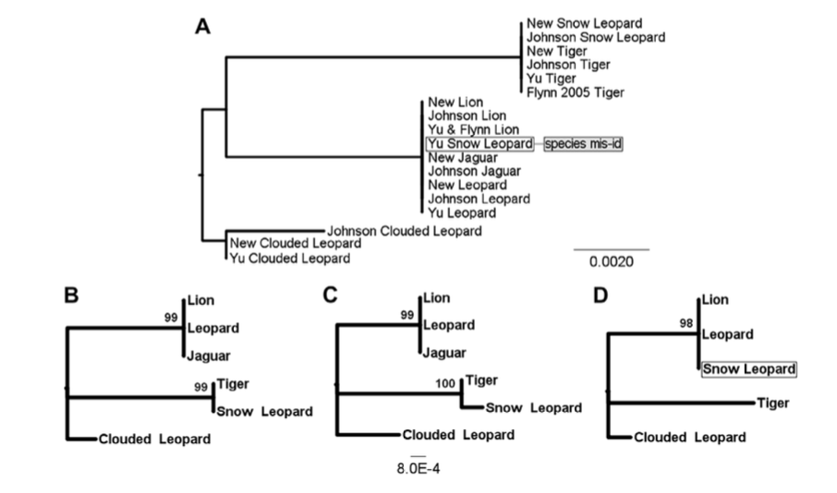
Figure 5
ML topology for TTR Gene with misidentification of the snow leopard sequence (A), and a clear distinction between two clades: a tiger-snow leopard clade and a Lion-Leopard-Jaguar clade with the Clouded Leopard as an outgroup (B & C). There is also a tree where misidentification is spotted (D).
Notes:
A preliminary analysis of published pantherid TTR gene segments revealed similar discordant levels of intra- and interspecies dissimilarity involving snow leopard and lion sequences.

Slide 12
Figure 6
A: ML of the Supermatrix with Bootstrap on the top number, the Bayesian Posterior Probability on the lower left, and the BEST posterior probabilities on the lower right.
B: Unrooted results with bootstrap shown on the left and BPP on the right.
Notes:
MAXIMUM LIKELIHOOD analysis based on the complete Supermatrix.
Shows a Lion-Leopard Monophyly, with the jaguar being a sister taxa, and Tiger-Snow Leopard monophyly
The X chromosome partition also recapitulated lion–jaguar monophyly with significantly greater support using BI than ML, consistent with the non-conservative nature of the Bayesian method
The rooted mtDNA partition did not support tiger–snow leopard monophyly, and only received low support when unrooted
Branch length in unrooted tree is far off from each other.

Slide 13
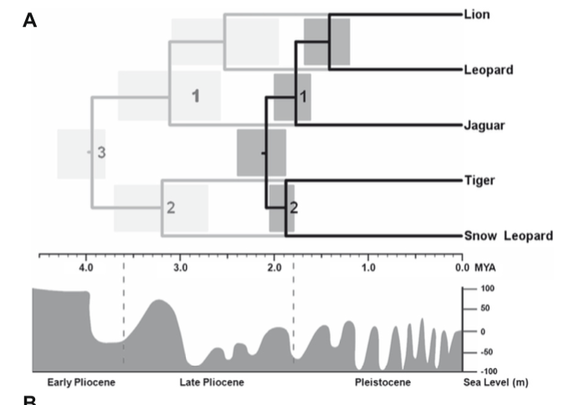
Figure 8
Divergence time (minimum) estimates in MYA. Provides explanation for the rapid radiation that these big cats went through ~3-4mya.
Notes:
Divergence times estimated using MULTIDIVTIME with fossil calibrations: (1) 1.6 MYA minimum (2) 1.8 MYA minimum (3) 3.8 MYA minimum. Shading indicates node 95% credibility intervals. Black tree represents times estimated with fossil calibration (3) removed, and grey tree estimated with fossil calibration (3) included.
There is no evidence from divergence times (with their broad confidence intervals) and historical and present species distribu- tions that would suggest an obvious mechanism for speciation by allopatry within Panthera.

Slide 14
Conclusion of Paper
There was an evident monophyletic relationship between the Lion and Leopard.
Two distinct clades were observed within the Panthera species:
Lion-Leopard clade with the Jaguar being part as a sister taxa.
Tiger-Snow leopard clade - showed low support during bootstrapping the unrooted tree (Fig. 6)
Notes:
Our 47.6 kb combined dataset was analyzed as a supermatrix and with respect to individual partitions using maxi- mum likelihood and Bayesian phylogenetic inference, in conjunction with Bayesian Estimation of Species Trees (BEST) which accounts for heterogeneous gene histories. Our results yield a robust consensus topology supporting the monophyly of lion and leopard, with jaguar sister to these species, as well as a sister species relationship of tiger and snow leopard. These results highlight new avenues for the study of spe- ciation genomics and understanding the historical events surrounding the origin of the members of this lineage.

Slide 15
Reconstruction: Software & Accession numbers used
Sequences assessed from GenBank
Accession numbers used:
AHF96250.1 – Panthera Leo
ABB22892.1 – Neofelis Nebulosa
AIY56297.1 - Panthera Onca
ABP73331.1 - Panthera Onca
ABP73321.1 – Panthera Tigris
ABP73308.1 – Panthera Pardus
Aligning the sequences was done with MPI Bioinformatics Toolkit.
Used the cytochrome B protein sequence.
Built a ML and Max Parsimony tree through MEGAX program.
Bootstrap replication: 100

Slide 16
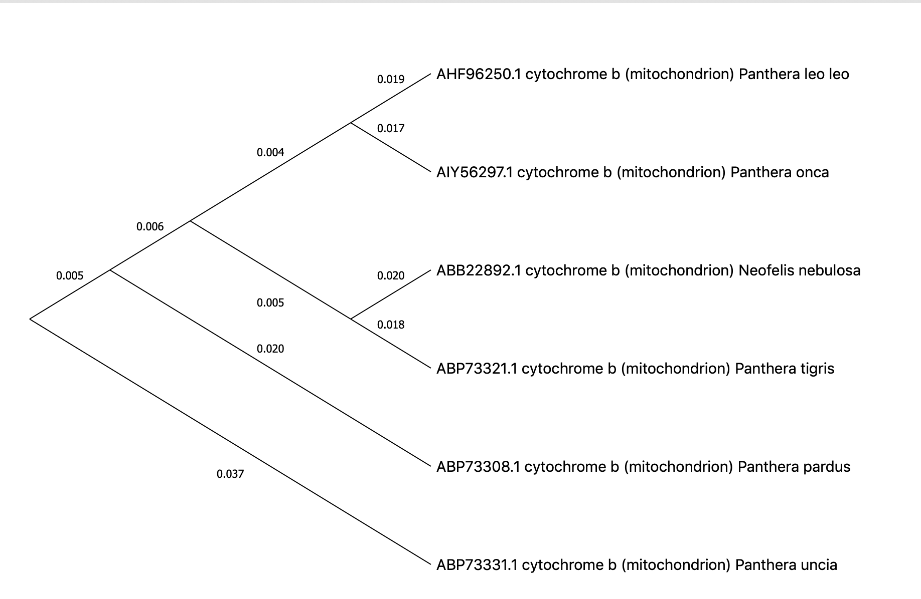
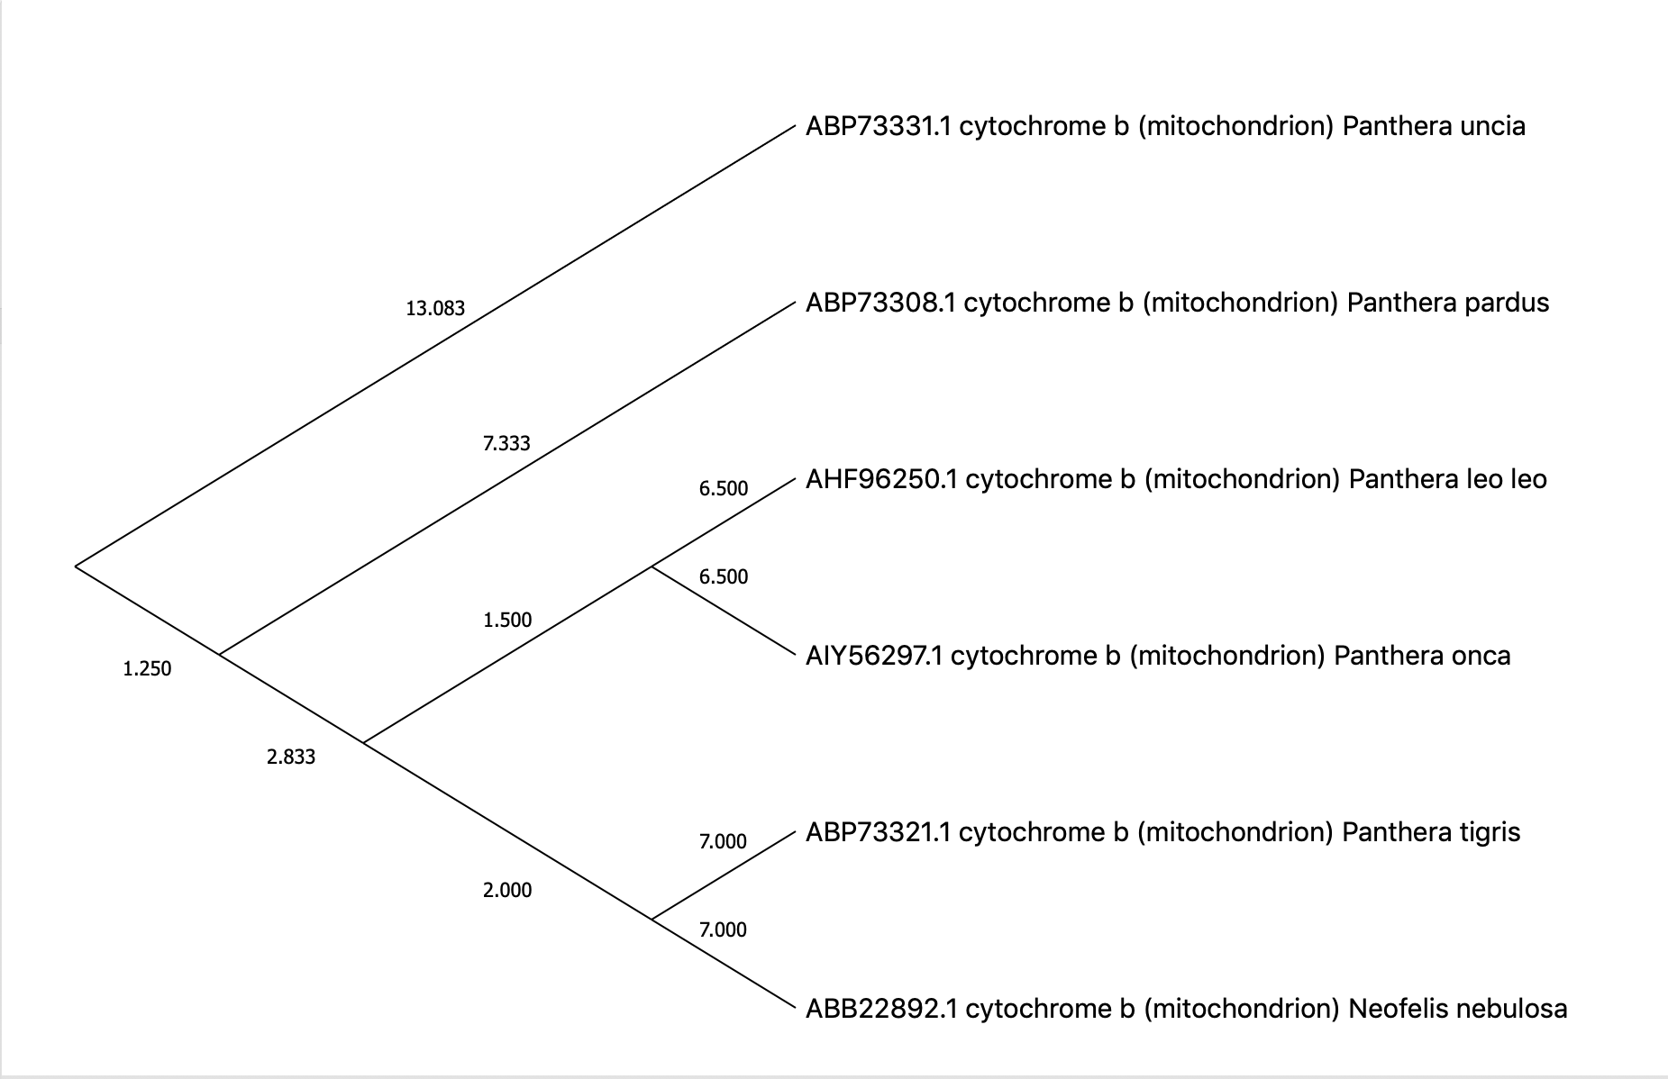
Reconstruction: ML and Max Parsimony
Max Likelihood
Max Parsimony

Slide 17
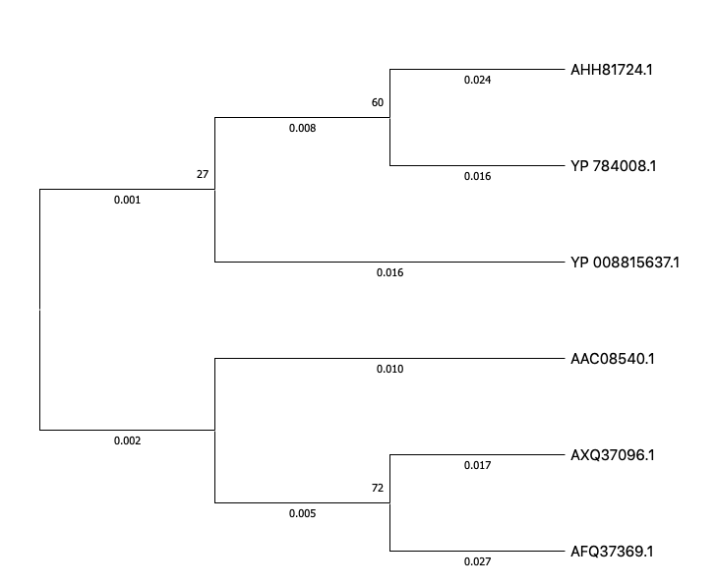
ML attempt 2
Bootstrap Replication: 100
Accession Numbers:
AHH81724.1- LION
YP 784008.1- CLOUDED LEOPARD
YP 008815637.1- JAGUAR
AAC08540.1- TIGER
AXQ37096.1- LEOPARD
AFQ37369.1- SNOW LEOPARD
Notes:
The evolutionary history was inferred by using the Maximum Likelihood method and Jones et al. w/freq. model [1]. The tree with the highest log likelihood (-1373.18) is shown. The percentage of trees in which the associated taxa clustered together is shown next to the branches. Initial tree(s) for the heuristic search were obtained by applying the Neighbor-Joining method to a matrix of pairwise distances estimated using the JTT model. This analysis involved 6 amino acid sequences. There were a total of 379 positions in the final dataset.
Overall low bootstrap results, low results

